Slide 1
CPsc501 Tutorial 4
Wikass Yousaf Raja

Slide 2
about me
CPSC Info Sec
Took CPSC 501 with Jonathan in Fall 2019
Full-stack Software Engineer
wikass.raja@ucalgary.ca
https://www.linkedin.com/in/yousaf-raja/
I usually go by Yousaf

Slide 3
about this coUrse
Lots of practical knowledge from a sotware engineering perspective
Difficulty ramps up a bit towards the end so watch out for that
Tutorials are recorded automatically and should be available on d2l

Slide 4
resources/links
Email
Tutorial specific discord group https://discord.gg/pTZA6j
Slides from F2019 http://pages.cpsc.ucalgary.ca/~seyedarshia.hosseini/courses/cpsc501/
My slides https://github.com/YousafRaja/CPSC501Tut4
Note that you should focus on the F2019 slides. My slides are mostly for my own reference as I go through the tutorial demonstrations.
https://docs.gitlab.com/ee/user/markdown.html
https://git-scm.com/book/en/v2/Getting-Started-Installing-Git

Slide 5
git basics
Create a local repo
Create a new project
Git checkout, git commit, git status
git add
git rm, git mv – similar to rm, mv
Change → Stage (git add) → Commit (git commit –m “update”) → Push
→ Merge

Slide 6
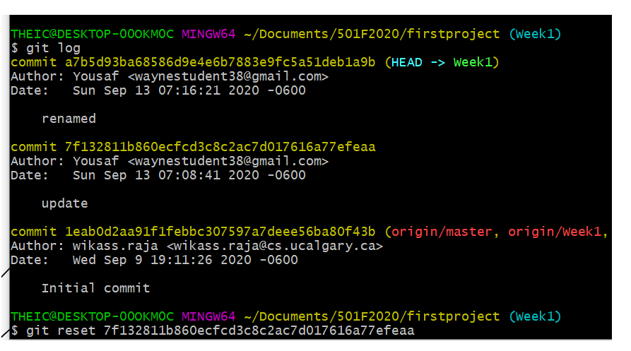
reverting committed changes

Slide 7
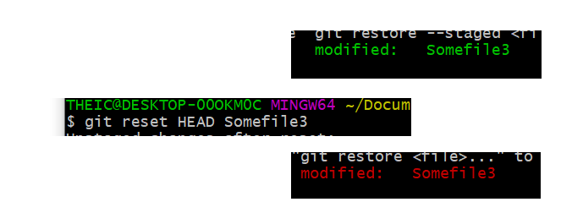
unstaging changes

Slide 8
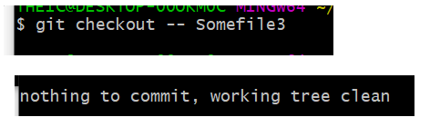
undoing changes

Slide 9

Branching

Slide 10
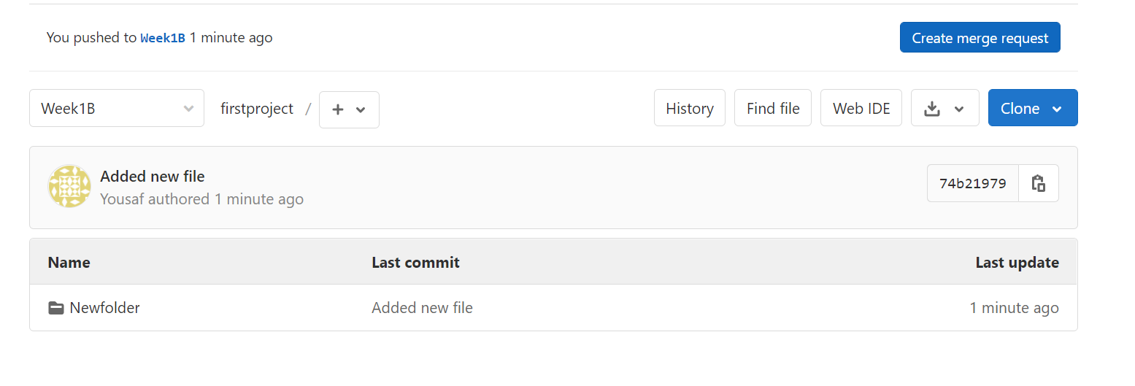
merging

Slide 11
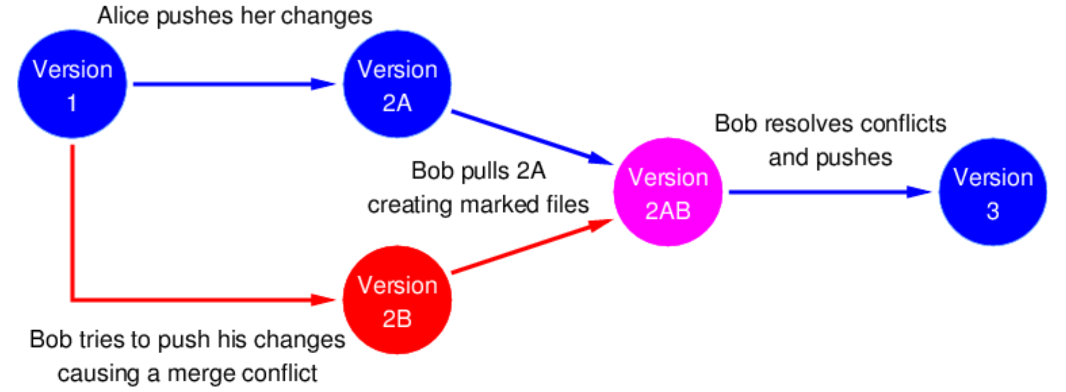
Merge conflicts
Branch1 contains committed changes (not yet merged)
Branch2 contains committed changes on the same line (not yet merged)
Git has no way of knowing which changes to keep, this is called a merge conflict.

Slide 12
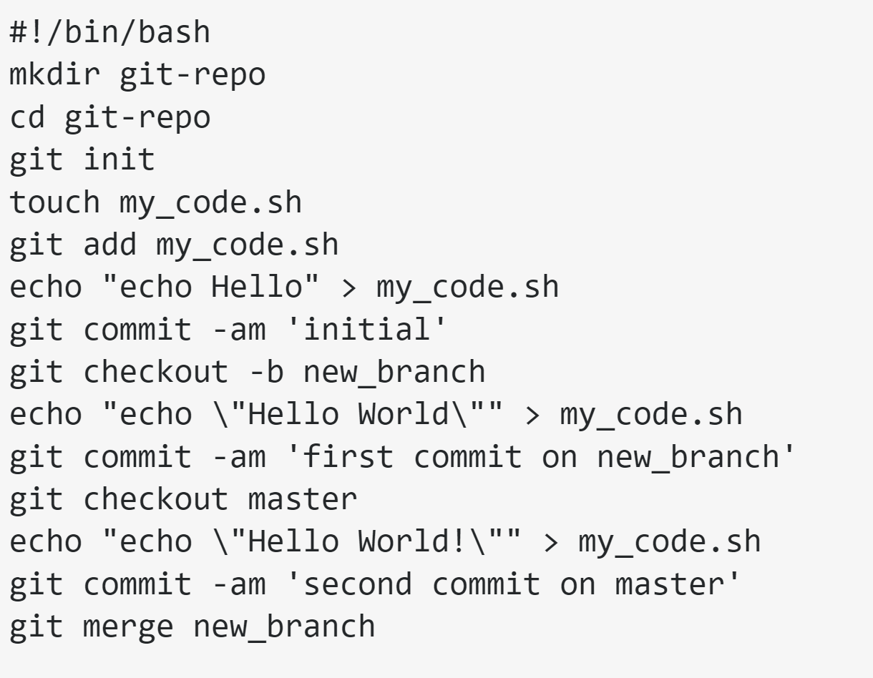
creating a merge conflict
Notes: - git commit –am, lets you skip the git add step - You may need to escape the ! character as well.
https://stackoverflow.com/questions/33454605/intentionally-create-merge-conflict

Slide 13
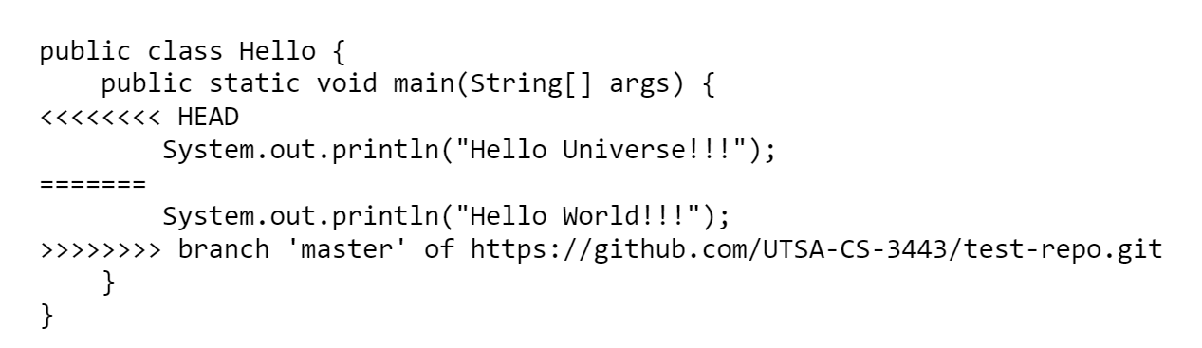
Resolving a merge conflict
This is one of the areas where IDE tools or plugin can really help. i.e. Instead of manually editing, you would just click on the code block that you wish to keep. You probably won’t have many merge conflicts when you’re working by yourself but if you’re working with others as is often the case in the real world, this is something you will likely run into.

Slide 14
gfm format
https://docs.gitlab.com/ee/user/markdown.html
GFM (Gitlab FLavored Markdown) is an extension of MD format. You’ll be using GFM for Assignment 1. Note that you can edit and preview any document saved as .md on gitlab.

Slide 15
recommended reading
https://hackernoon.com/understanding-git-fcffd87c15a3 Tips: - Get in the habit of using version control whenever you can. - Also learn about .gitignore. - Students can get a pro github account which lets them create private repos (although this course will mostly focus on gitlab).

